Slide 1
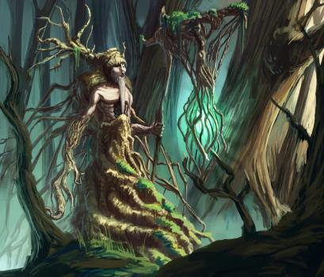
HEROE’S JOURNEY
SAVREMENA GIMNAZIJA

Slide 2
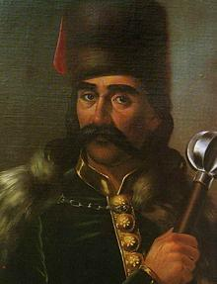
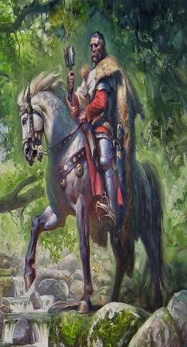
Marko Kraljević
Marko Kraljević is a mythological being. In the songs, he is presented as fearless. According to him, the people were encouraged, and at that time the people needed it the most because they were surrounded by war. Marko had his horse named Sharac, and wolf fur around his neck.

Slide 3
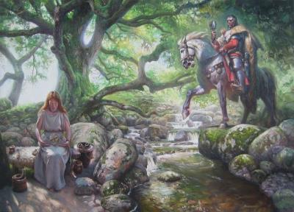
Marko Kraljević
Marko Kraljević or also known as Marko Mrnjavčević, king, military leader, politician (around 1335 - May 17, 1395), is the central and most controversial figure of Serbian medieval epic poetry.
As a son of King Vukašin Mrnjavčević and mother Jelena (according to the folk tradition of Jevrosima) was born during the greatest glory of the Serbian state, Dušan's empire. King Vukašin ruled as co-ruler of Emperor Stefan Uros V, on the territory of today's Macedonia and Kosovo and Metohija. Apart from historical facts, Marko Kraljević left a deep mark in Serbian medieval epic poetry.
Having in mind the factual facts about his state life, on the one hand, and the way in which numerous songs present him (something like Serbian Robin Hood), it can be freely said that Marko Kraljević is the greatest mystery of Serbian epic folk songs.
His "epic destiny" far surpassed his state significance - Kraljevic Marko is by far the most sung character and protagonist not only of the time in which he lived - the myth of his miracles placed him in legend at Vila Ravijojla, as well as his favorite Sharc and the obligatory mace of 66 eyes.

Slide 4
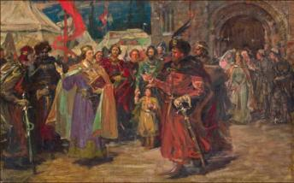
Marko Kraljević
It is sung in prose and poetry, not only by Serbs, but also by Bulgarians, Macedonians, Croats, Slovenes, Montenegrins… Bulgarian stories about King Mark, a freedom fighter to whom the prophetess fairies gave superhuman strength, are especially widespread. He is sung as a hero, protector of the weak and powerless, righteous and merciful, mythically empowered to the heights of ancient heroes.
In the area of ​​Croatian lands, the oldest record about Kraljević Marko is the work of the poet Petar Hektorović, the author of a poem about him and his brother Andrijaš. Croatian writer Petar Preradović wrote the play "Kraljević Marko", Serbian writer satirist Radoje Domanović wrote the short story "Kraljević Marko, for the second time among Serbs", and Ivo Andrić mentions him in the cult novel "Na Drini ćuprija".
The most famous songs sung about Kraljevic Marko are certainly: "Marko Kraljevic and Musa Kesedzija", "Plowing Marko Kraljevic", "Marko Kraljević cancels the wedding", "Uros and Mrnjavčevići" and "Death of Marko Kraljević", recorded by Vuk Karadžić.
The myth of Prince Marko instilled and maintained hope in the subjugated and attacked people and the dream of freedom that they had dreamed of for five hundred years.

Slide 5
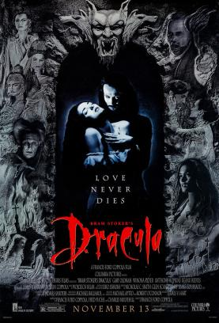
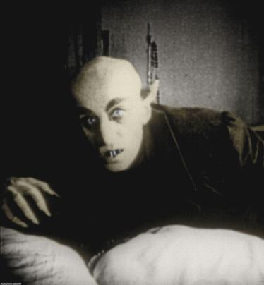
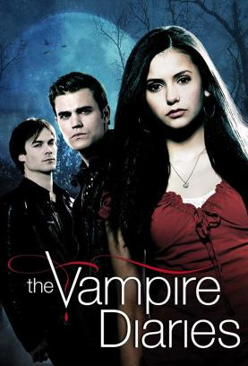
Does this seem familiar to you?
I’m pretty sure it does, so let’s learn what it really is and why is it so popular in literature and cinematography.

Slide 6
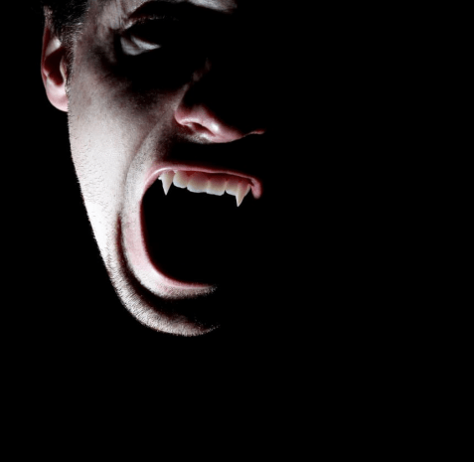
Who or what are vampires?
Vampires are mythological creatures that represent walking corpses who hunt living people at night and use their sharp fangs to drain and drink blood from victim through the victim’s neck.
In different cultures, vampires are attributed with some other characteristics such as: immortality, hypersensitivity to the sun, hypnotic abilities, powers of transformation and flying. Also, the feature that is represented in the myths about vampires is that they don’t have a reflection in the mirror.
Many of these vampire characteristics were invented and adapted from original myth in order to interest the audience through stories, series and movies about these creatures.

Slide 7
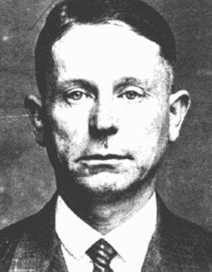
The origins of Vampires
The first mention of the term vampire and the phenomenon called vampirism in general happened in 1725 on the territory of Serbia. Then, a resident of village of Kisiljevo, Petar Blagojević, passed away and shortly after his death, many strange deaths began to occur in the village.
The victims would wake up very weak in the morning, pale, with two wounds on their necks that looked like human canine bites, and all of the victims claimed that the deceased Petar Blagojević came to them in a dream and suffocated them. They died within two hours of waking up.
Residents of Kisiljevo decided to exhume the body of Petar Blagojević and to stab a hawthorn stake in his heart, according to the old Serbian belief.
When they exhumed the body, they noticed that there wasn’t an unpleasant odor specific to the dead bodies, the body looked like it was buried yesterday and not two weeks ago. His hair, nails and facial hair continued to grow, and in the his mouth they saw fresh blood thought to have belonged to one of his victims. After they stabbed him with a stake, strange deaths stopped happening.

Slide 8
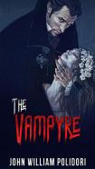
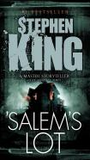
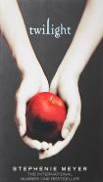
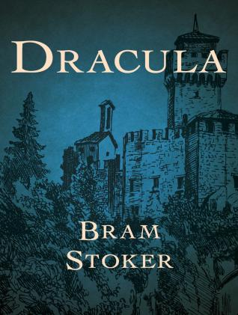

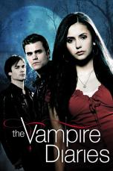
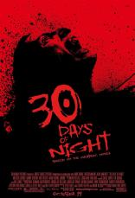
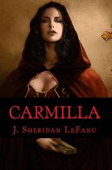
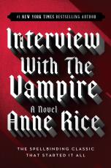
Vampires in Literature and Cinematography - examples

Slide 9
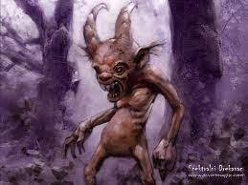
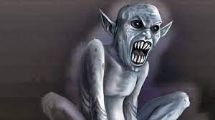
2021 · Visual & performing arts major for college
Drekavac
According to mythology and legends, Drekavac is an undead creature, like a vampire. It originated from a deceased unbaptized child who wanders in the dark and screams because of the pain known only to unbaptized souls who stand at the crossroads between heaven and hell.
They say Drekavci attack people who find themselves late at night near a cemetery, river, lake or forest, by jumping on their backs and forcing them to walk all night. Most people who have researched this mythical creature in detail say that only the people who dreamed of him can see him.

Slide 10
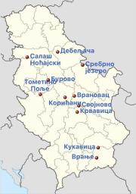
How people describe Drekavac.
On December 6, 2009, a text was published, mentioning Drekavac, which appeared in Burovo near Lazarevac. According to the description of the witness, these small and noisy creatures have a long body similar to a cat and a long tail like squirrels, and on their head they have patterns similar to the patterns on the face of a panda
On December 9, 1992, a text was published mentioning the name of a mystical being. Villagers from Krvavica near Kruševac found the remains of an unknown animal. In their opinion, it was a Drekavac. The animal was 80 cm long, covered with hairless skin and resembled a dog. She had a snake-shaped head with long fangs and a long neck,

